Slide 1
EV4-vvvf Drive Signalling
Dr. K. Ferhat Celik
Blain Hydraulics
ferhat.celik@blain.de

Slide 2
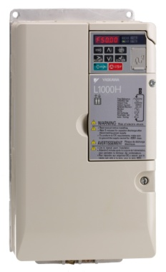
A practical solution for Green Hydraulic Lift applications
EV4
DOWN travel : Conventional (mechanical)
Lift controller
UP travel with inverter
EV4 Valve
EV4
YASKAWA
L1000H
OPEN loop control
Pump
Temp. sensor
Motor

Slide 3
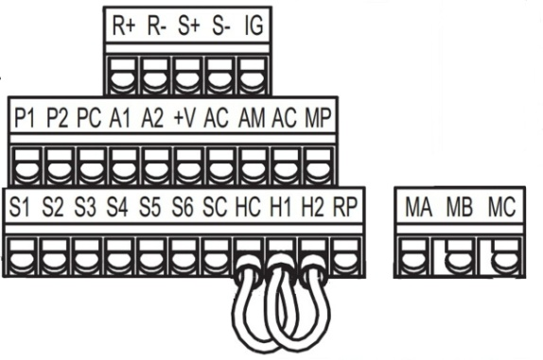
Connecting the temperature converter
Temperature Converter
1 2 3
L1000H
Temperature Sensor
Temperature sensor is dipped into the oil.
4 5 6
A1
+
Power supply
12V to 35V dc
-
AC

Slide 4
Signaling from lift controller
Decel.
switch
L1000H
Elevator speed
1
Stop
switch
2
Input
common
Decel.
switch
Travel signals
Output frequency
1
Stop
switch
Full speed travel→ S1+S4
Intermediate full sp travel→ S1+S5
Inspection speed travel→ S1+S6
Leveling speed travel→ S1
2
3
S4 – Speed selection signal
S1 – Up run signal
Energy to motor contactors
Base block signal
S1 is up travel signal, without S1 elevator will not move.
S4, S5 and S6 are speed selection signals, without these elevator will move with levelling speed.
When more than one speed selection signals are used the lowest speed selection is exucuted.

